Slide 1
Annual Wellness Visit
Ambulatory Care Nursing Simulation Toolkit

Slide 2
Name, DOB | Charlie Plummer 10/30/19XX (age 78 y/o)
Personal History | Retired, Single (Divorced)
Family Medical History | Diabetes (mother, 2 siblings) Heart disease (father, 3 siblings) | Arthritis (1 sibling) Cancer (mother, 1 sibling)
Past Medical History | Type 2 diabetes Hypertension Hyperlipidemia | Osteoarthritis Depression
Past surgical history | Inguinal hernia repair Right total knee replacement
Medications | Glucophage (Metformin), 500 mg by mouth daily Atorvastatin (Lipitor), 20 mg daily Lisinopril, 20 mg daily | ASA, 81 mg daily Acetaminophen 1250 mg extended release, as needed for pain Dragon Balm (over the counter
Providers | Dr. Kelly Riis (ophthalmology) Dr. Samuel Ojumu (endocrinology)
Patient Health Record

Slide 3
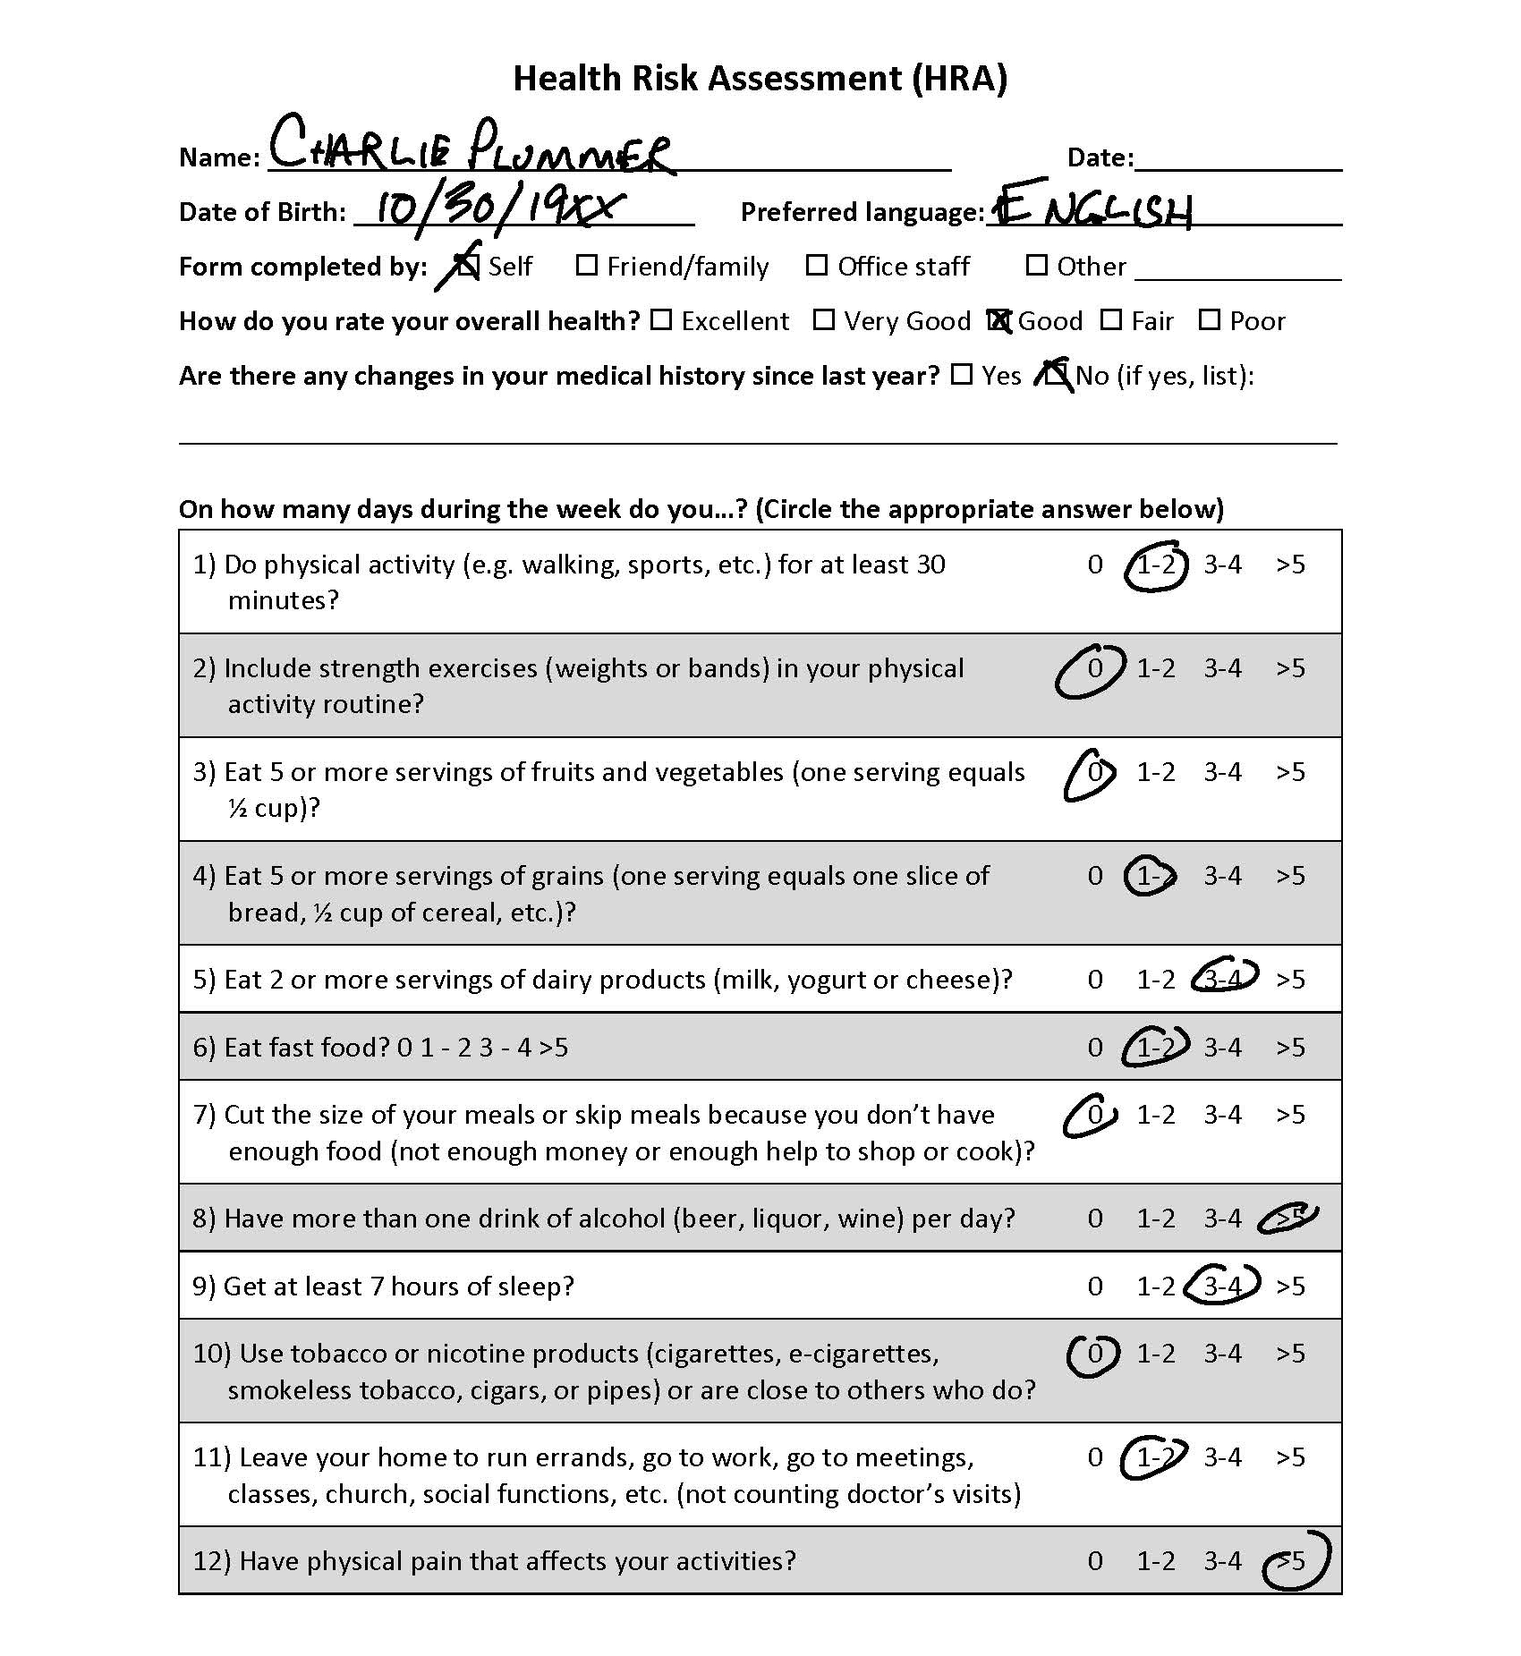
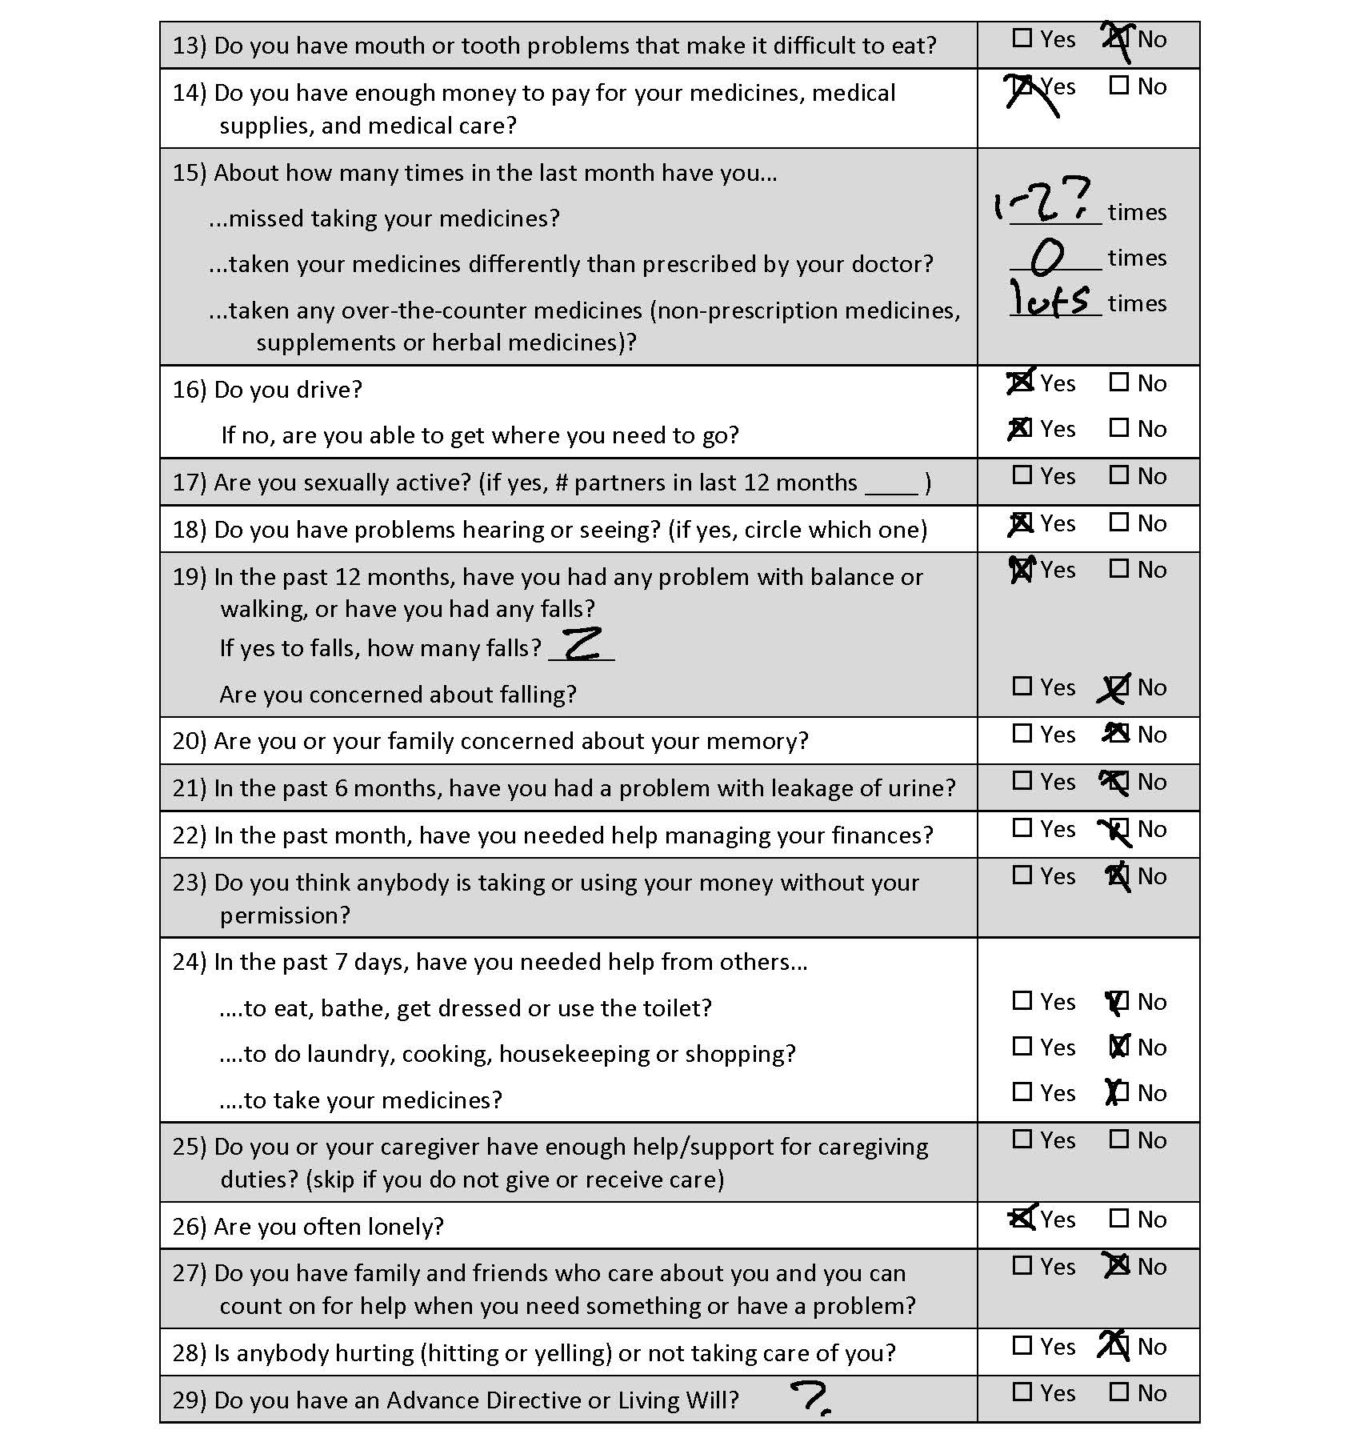

Slide 4
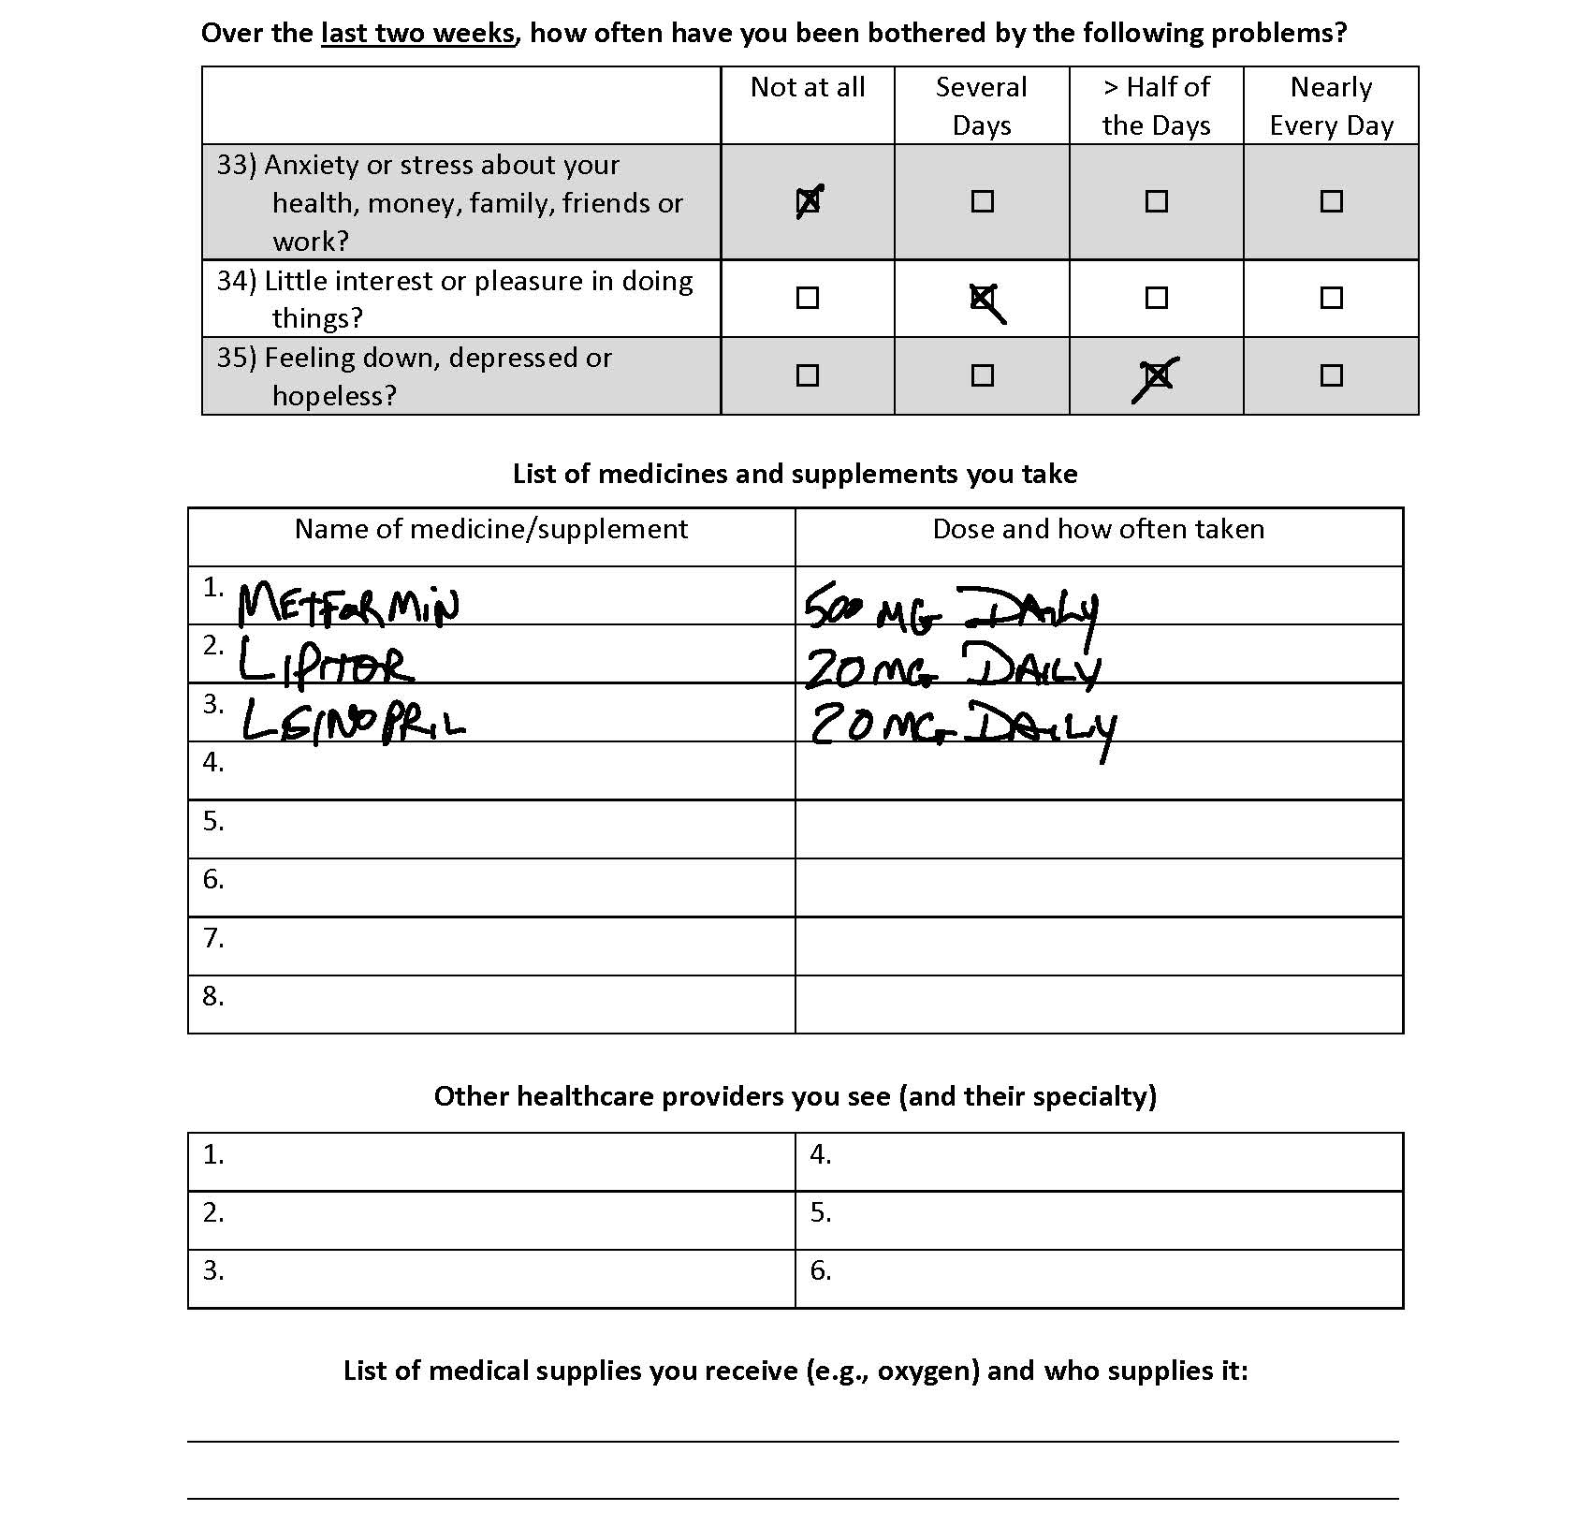

Slide 5
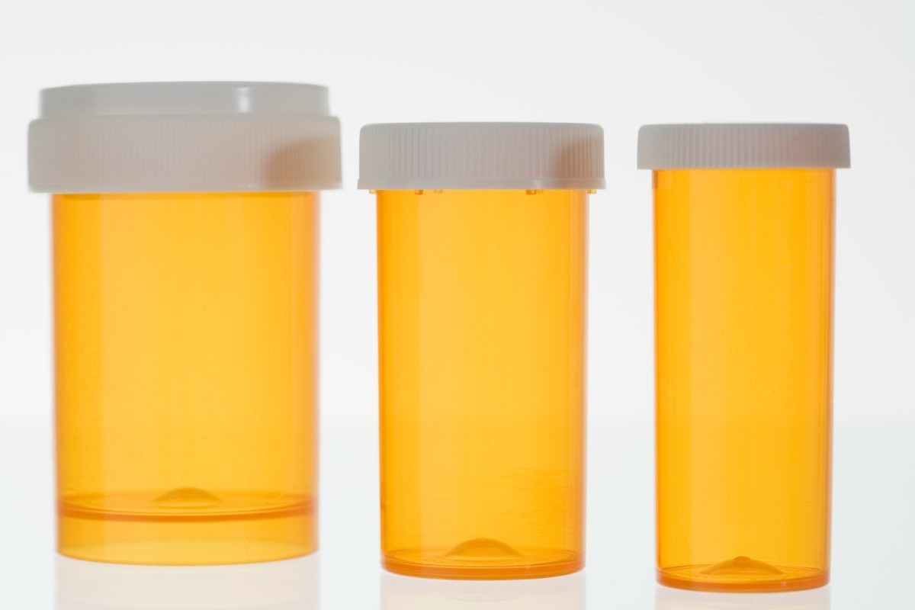
Plummer, Charles
DOB: 10/30/19XX
Metformin HCL
Extended release tablets
500 mg
Take one pill by mouth daily
Plummer, Charles
DOB: 10/30/19XX
LIPITOR (atorvastatin calcium) tablets
20 mg
Take one pill by mouth daily
Plummer, Charles
DOB: 10/30/19XX
Lisinopril tablets
20 mg
Take one pill by mouth daily

Slide 6
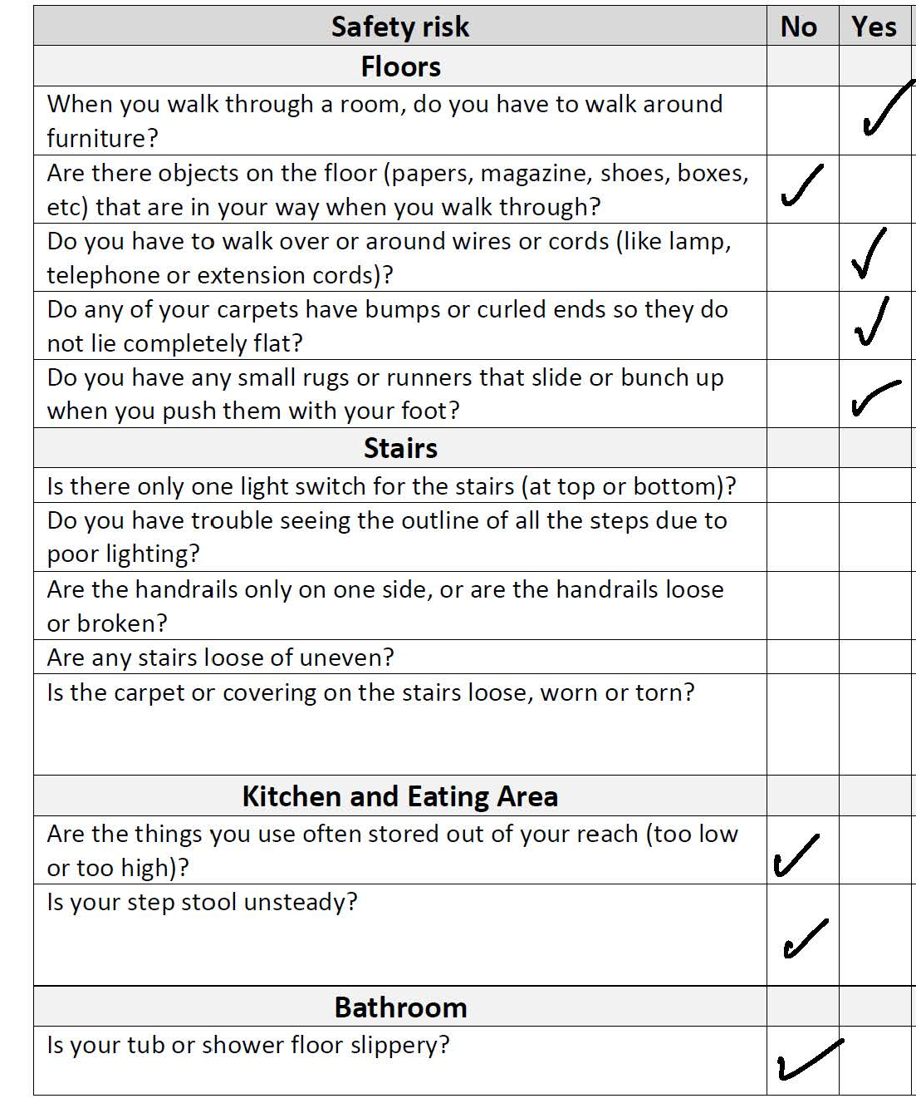
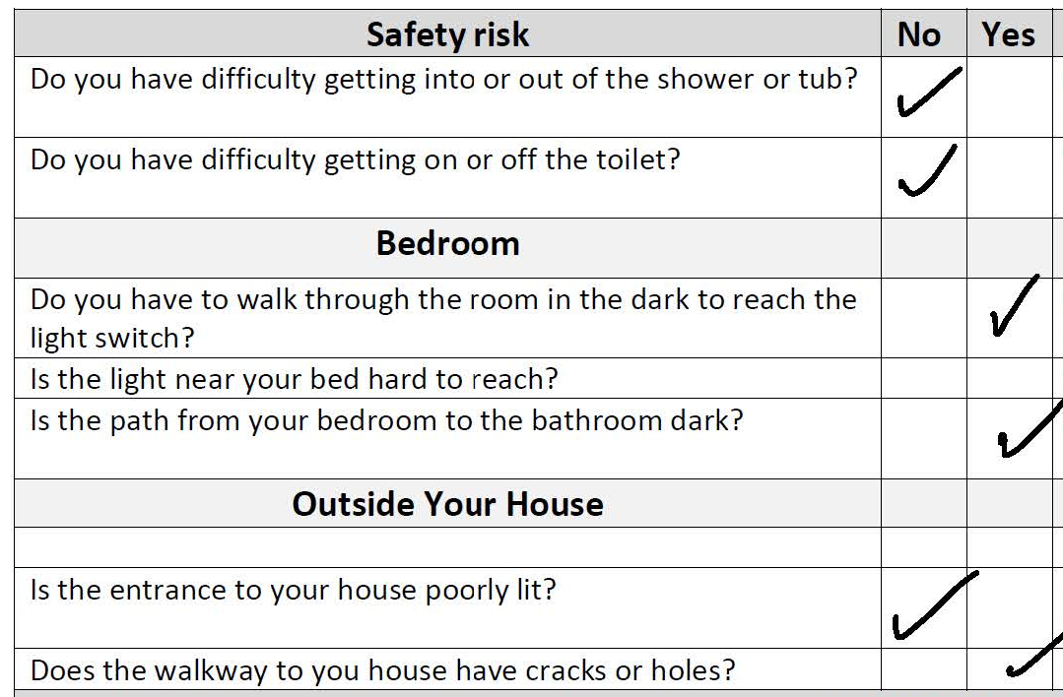
Home Safety Checklist

Slide 7
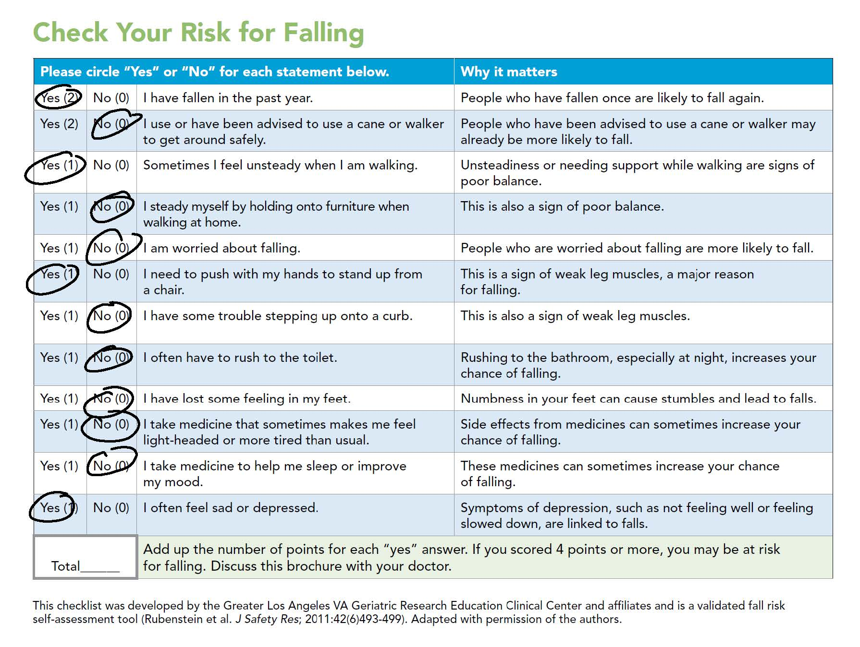

Slide 8
BP
140/85
Pulse
85
Resp
Temp
97.3°F
16

Slide 9
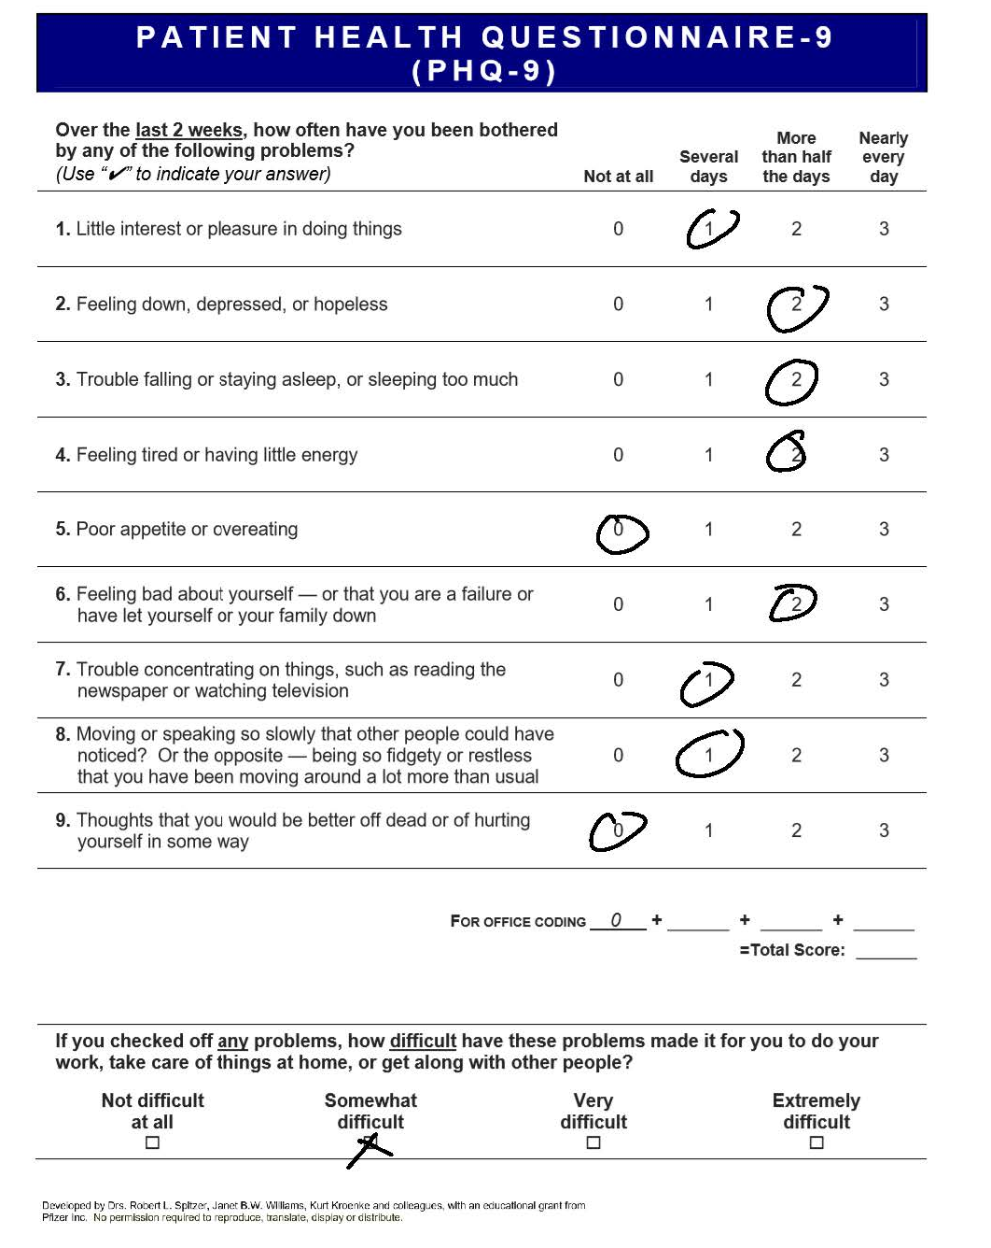

Slide 10

Mini-Cog: Clock

