Slide 1
Lorenza “Enzo” Anderson
NCLIN 422
UW School of Nursing Simulation
Notes:
By Slides by Sarah Manji

Slide 2

Enzo
DOB: 8/1/20XX (9 years old)

Slide 3
Health Record Information
Home Medications (brought by parent)
Current Medications:
1. Albuterol MDI (90 mcg/puff), 2 puffs every 4-6 hours as needed for symptoms
2. Fluticasone MDI (110 mcg/puff), 1 puff twice daily
3. Hydrocortisone cream, 10%, apply to affected area 2 times per day as needed
4. Cetirizine dissolvable tablet, 10 mg once daily

Slide 4
Vital Signs
BP
100/55
Pulse
105
Resp
SpO₂
92%
28
Temp
98.3°F

Slide 5
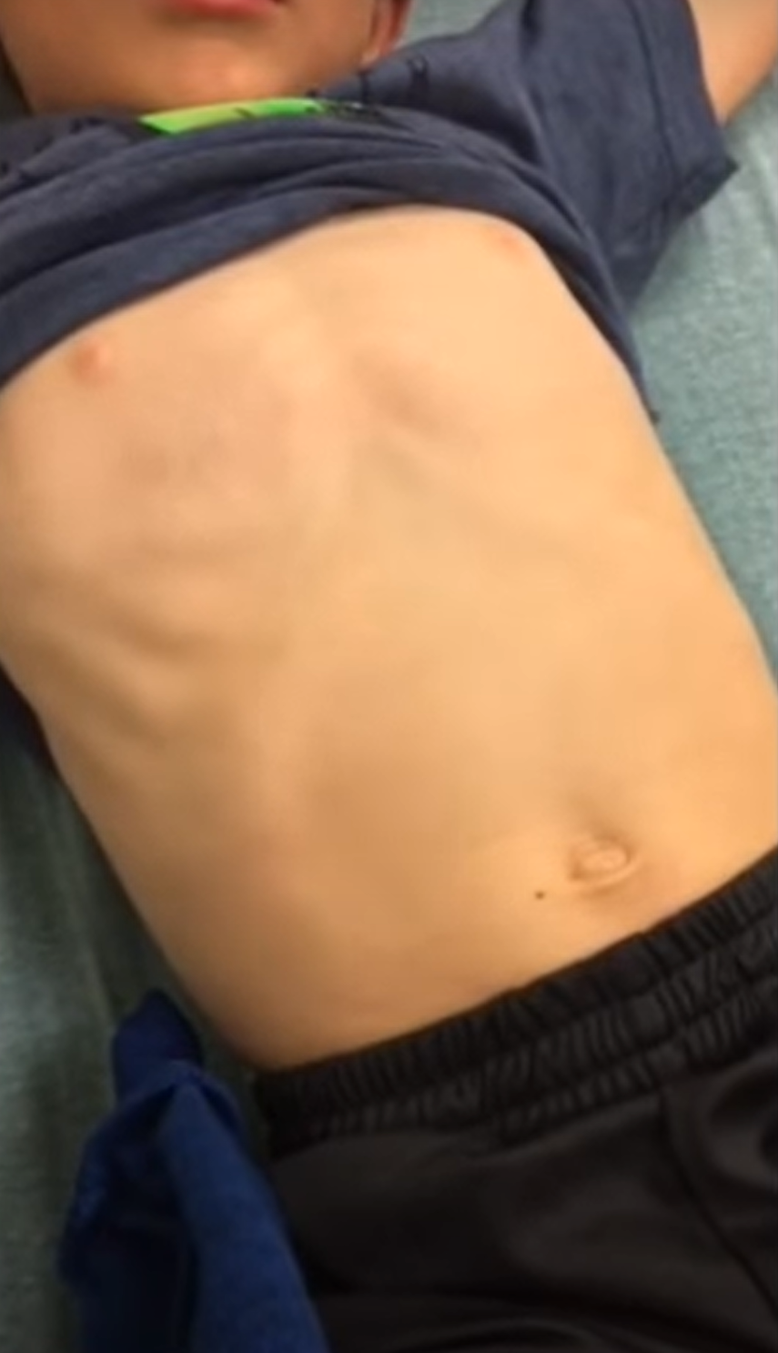
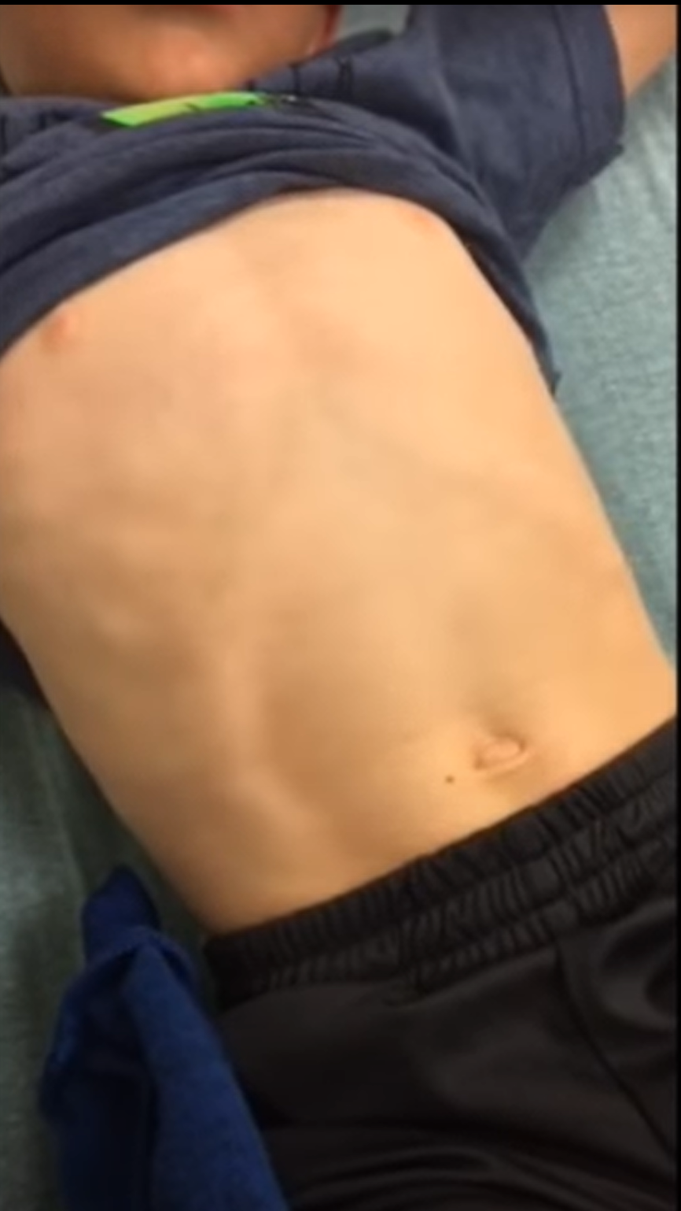
Note: No Nasal Flaring
https://www.youtube.com/watch?v=qsFR8evfrK8

Slide 6
Lung Auscultation - Initial
https://youtu.be/n6YMiox1P1k
(start at 00:40)

Slide 7
Respiratory Score

Slide 8
Provider Assessing Patient…

Slide 9
Provider Orders
Albuterol MDI (90 mcg/puff), 8 puffs with spacer now
Dexamethasone (0.6 mg/kg), 2.6 mL by mouth now

Slide 10
Vital Signs after Albuterol
BP
100/55
Pulse
100
Resp
SpO₂
95%
24
Temp
98.2°F

Slide 11
Vital Signs 45 Minutes after Albuterol
BP
102/58
Pulse
90
Resp
SpO₂
97%
22
Temp
98.3°F

Slide 12
Lung Auscultation – 45 min after treatment
https://youtu.be/xnubmmeDWrw

Slide 13
Discharge Orders
Albuterol MDI (90 mcg/puff), 2 puffs every 4-6 hours as needed for symptoms
Fluticasone MDI (110 mcg/puff), 1 puff twice daily
Dexamethasone solution (0.5mg/5 mL), 2.6 mL by mouth, give 24 hours after first dose
Follow up with RN in 3 days

