Slide 1
Ambulatory Care EHR Inbox Simulation – Part 2
Zoom session presentation
Laura Sabin Lopez BSN, RN, PHN M.S. Candidate, Clinical Informatics
Notes:
Introduce self and role
Describe CIPCT project and Optional post Zoom eval
Inform students that they will receive documents in the chat
Send links to:
Julie briggs book (should already have it)
SOAP note template
Triage call transcript
Chart review document
SBAR template
Inform students that they may be prompted to download or save forms
Ask students if they have any issues accessing documents and/ or book
Send all in advance during set up process

Slide 2
Acknowledgement
This website is supported by the Health Resources and Services Administration (HRSA) of the U.S. Department of Health and Human Services (HHS) as part of an award totaling $2,090,495 with 0 percentage financed with non-governmental sources. The contents are those of the author(s) and do not necessarily represent the official views of, nor an endorsement, by HRSA, HHS or the U.S. Government.
©2020, University of Washington School of Nursing, All rights reserved.

Slide 3
SIMULATION
Required text: Telephone Triage Protocols for Nurses / Edition 5 by Julie Briggs RN, BSN, MHA
EHR in ambulatory care lecture module 1.0 hrs
Before class simulation module: Inbox basics and message prioritization 0.5 hours
Triage call video demonstration
Activity: Document a SOAP note
SBAR video
Activity: SBAR Practice
Debriefing
Optional evaluation
Notes:
Should have already preformed the SIM module and lecture
Describe what we will cover today
Triage call video demonstration
Activity: Document a SOAP note
SBAR video
Activity: SBAR Practice
Eval ( explain that it is the entire EHR content, lecture, sim module, and this simulation)

Slide 4
SIMULATION
Learning Objectives:
Describe the role of the nurse in managing and responding to patient messages received through electronic communication.
Prioritize patient messages using the triage principles and the nursing process to emphasize patient safety.
Formulate typed and verbal responses to patients’ electronic communications that are clear, sensitive, and specific.
Document nursing care provided through EHR contact, with telephone or electronic follow-up, using a standardized charting approach.
Provide a clear and succinct report to an interprofessional healthcare worker using the SBAR format.

Slide 5
Pre-briefing
This is a SAFE learning environment
Everyone is expected to participate in the simulation, breakouts, and debriefing
Have documents ready to use:
Briggs triage protocols
SOAP Note Document
SBAR Template
Chart Information
Notes:
Make sure students remember to adhere to the Simulation Agreement. Note that this is a safe setting to make mistakes. No recording/screen shots
Send out handouts listed above in the chat – make sure everyone has them

Slide 6
Pre-lab Question 1
What is your role, as an RN, in managing and responding to patient messages received through electronic communication?
What are your roles in the cases you reviewed? In the top priority case?
Notes:
SHORT discussion – maybe 2 minutes per question.

Slide 7
Pre-lab Question 2
What guidelines would you use to decide on the priority of messages - that is, how do you decide which messages are emergent, urgent, or non-urgent? What sources of information would you use?
Notes:
Discuss why Damon Mays is the most urgent, versus the other 2. SHORT discussion. 2-3 minutes.

Slide 8
Simulation
Review the chart message
Practice beginning a phone call to respond to an EHR message.
Listen to the sample phone call. Follow along on the Briggs triage protocol and take notes.
SOAP note
SBAR to another provider
Notes:
Review the expectations with the students.

Slide 9
Utilize the Diabetes problems and Depression protocols in Julie Briggs Telephone Triage Protocols for Nurses 5th edition in this triage exercise
Mays, Damon
Electronic Message
Received: today
Contact Damon Mays (Patient)
Mychart status (Active)
PCP: Dr. Abdullahi
Male, 46 y/o
DOB: 4/12/1975
Last weight: 280 lb (127.0 kg)
Problem list: Type II diabetes, major depressive disorder, hypertension
Allergies: none
Message: I’m writing for Dr. Abdullahi’s nurse. You helped me adjust my insulin doses last week. I’m having a hard week, and I think I need to adjust the dose again. My depression is worse, and I haven’t felt like eating. I see my psychiatrist in 3 days. Last night, my sugar was down at 55 and I felt really awful. I made myself eat a snack and that helped, but I’m worried that I might be on too much insulin. Should we adjust the dose? Damon
Notes:
Discuss how messages enter the inbasket : MA or front office staff may send a triage call to the inbasket or you may receive a message via the patient portal. In this case we received our message via mychart which is the patient portal in Epic.
Do you recall this patient from the inbasket module?
This patient was identified as the priority call back
Ask students to follow along in the diabetes and depression protocols
I hope you were able to review his chart. I have sent you a copy of his chart review to refresh our memory.
We will move through a triage call example w this patient
Keep in mind that sometimes need to switch protocols
Pay attention in the call for when the nurse switches gears/ changes protocol from diabetes to depression

Slide 10
Example Call
Notes:
Play Audio Call

Slide 11
Call Debriefing
How well was the call organized? Is there anything you would have done differently?
In what ways are telehealth technologies useful in providing care for this? What limits or barriers does the technology present?
How could you protect patient confidentiality during your work and communications?
If you were the patient, would this response have met your need? What else would you have liked to have known?
Notes:
Note here – would have confirmed patient identity, also consider how you would ask an African American person about pallor, note knowing their skin tone on a telehealth call (equity issue)?

Slide 12
Activity: SOAP Note
Break out rooms, in pairs. 10 minutes.

Slide 13
Key points to remember
Always know your state’s legal scope of practice and organizational policies and procedures regarding the nurse's role in telephone triage.
Consider all calls life threatening until proven otherwise
Err on the side of caution to avoid the risk in delaying treatment for potentially serious problems
Recognize knowledge deficits and use protocols to supplement knowledge to make appropriate triage decisions
Notes:
Refresher on triage principles

Slide 14
Key points to remember
Review the chart prior to the call, check for any allergies, contraindications, and past medical history
Document the call, the advice given, and the patient’s response to that advice
Notify the provider per organizational protocol
Always cite your source
Notes:
Refresher on triage principles

Slide 15
Activity: Document a SOAP note (small group breakouts)
S
Subjective
O
Objective
A
Plan
P
Assessment
Notes:
Review SOAP note documentation

Slide 16
Example SOAP note
Notes:
Make sure everyone has the SOAP note in the chat
Inform students they will be broken up into small groups
5 groups of 2
Each group can take time to review the chart (chart review document and transcript of the call for reference), then fill in the required fields. One student can choose to be the scribe and document the SOAP fields, name/date/time, reminder, and routing comments to PCP

Slide 17
SOAP Note Debriefing
What is the most important overall message to convey in the SOAP note? (i.e., what do you want to communicate to a health care worker who reads it in the future?)
Make SOAP Note as a whole group
Notes:
Ask if anyone would be willing to share their soap note

Slide 18
Activity: SBAR Team Communication
Notes:
We will review the SBAR technique for team communication

Slide 19
SBAR Video: Do’s and Don’ts
Notes:
In the next two videos we will explore SBAR dos and don’t’s
The first video will demonstrate what not to do, ineffective communication that does not use the SBAR technique
The next will be a more effective way to communicate with a provider utilizing the SBAR technique

Slide 20
No SBAR: Ineffective communication
Notes:
Play video

Slide 21
SBAR: Effective communication
Notes:
Play video

Slide 22
Small Group Break Out – 10-15 min
You are now going to notify the behavioral health provider Dr. Perkins that you have added Damon to her schedule. You will also notify Dr. Abdullahi in the routing comments in your message.
In small groups, create an SBAR for the behavioral health provider Dr. Perkins explaining the situation, Background, Assessment, and Recommendation.
Then document the routing note to the PCP
Notes:
Give 10-15 minutes
The person playing Dr. Perkins – ask probing questions if you need more information, make sure your partner covers all parts of the SBAR
Will call upon one group to share the SBAR and another to share their routing note

Slide 23
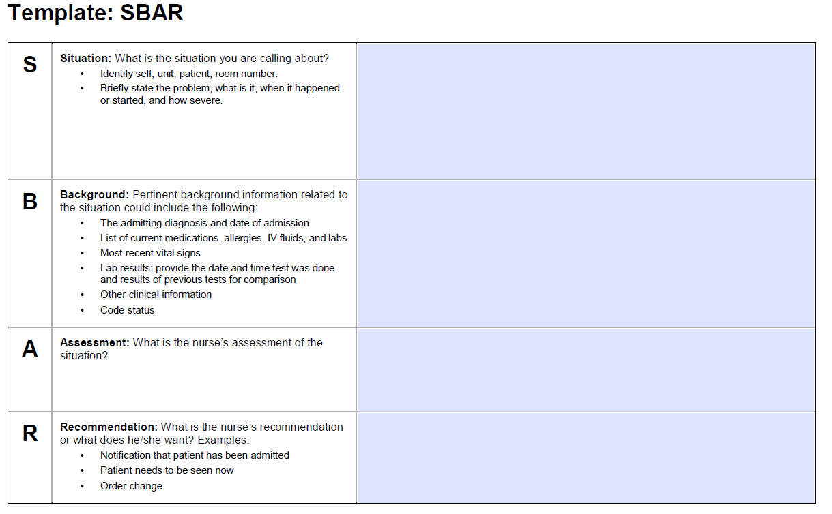
Activity: SBAR tool with template
SBAR: Situation-Background- Assessment-Recommendation
Institute for Healthcare Improvement ∙ ihi.org | This SBAR tool was developed by Kaiser Permanente.
Notes:
Small group break out
Make sure everyone has the SBAR tool in the chat. Last page is a fillable , choose a scribe in your group and we will reconvene in about 10 minutes to discuss the SBAR

Slide 24
SBAR Debriefing
How did the SBAR go? What went well? What could have been done differently?
What was your thought process in arriving at your recommendation? How does it help the provider to include “Recommendation” in the SBAR?

Slide 25
Debriefing of the Overall Simulation
How would you describe your experience with this simulation?
How did this change or expand your understanding of the ambulatory care nurse role?
How can you promote equity of ambulatory care using telehealth technologies? How could these technologies contribute to inequity?
Notes:
In equity consider varied populations – race, ethnicity, religious, age, veteran status, SES, etc.

Slide 26
How well did you achieve the learning objectives? What else do you think you need to do to address unmet learning objectives?
Learning Objectives:
Describe the role of the nurse in managing and responding to patient messages received through electronic communication.
Prioritize patient messages using the triage principles and the nursing process to emphasize patient safety.
Formulate typed and verbal responses to patients’ electronic communications that are clear, sensitive, and specific.
Document nursing care provided through EHR contact, with telephone or electronic follow-up, using a standardized charting approach.
Provide a clear and succinct report to an interprofessional healthcare worker using the SBAR format.

Slide 27
Final Thoughts
What is one thing you learned that you will take into your practice?

Slide 28
Evaluation
Notes:
Optional evaluation
You may leave
If you choose to do the evaluation please click on the link in the chat
https://docs.google.com/forms/d/e/1FAIpQLSeT5-xG5vHpPzHG3txIdb7FiTrGRMOQ-3PhI4Kc8Y4qCAx9nQ/viewform

