Slide 1
Psychological First Aid (PFA)
Simulation Guide
Emily Ishado, LICSW & Diana Buchanan, PhD

Slide 2

Patient: Ms. Roberta Jones
78-year-old African-American, female identified patient
Presenting to clinic for her annual physical exam
Patient only has a diagnosis of hypertension, which has been controlled with metoprolol.
You are a nurse working in an ambulatory care clinic within a large healthcare system that has multiple departments, including pharmacy, social work/behavioral health, and rehabilitative services.

Slide 3
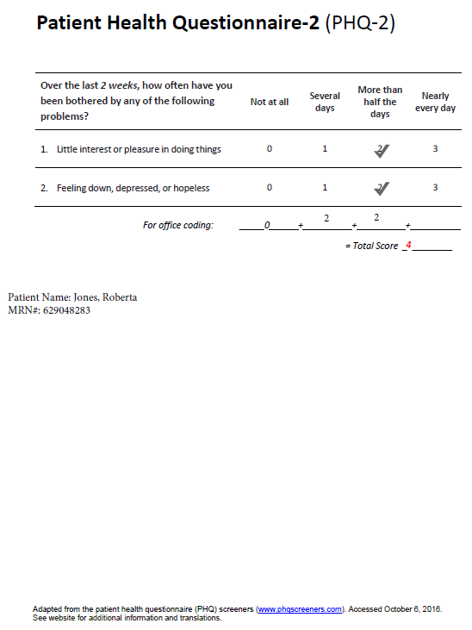
Warm Hand-Off of Patient Ms. Jones
MA provides a report of Ms. Jones’ vital signs (below) along with results of PHQ-2 Questionnaire (right).
MA asks you to follow up to complete the full PHQ-9.
HR | 67
Spo2 | 97%
BP | 122/68
RR | 16
Temp | 98.4°F

Slide 4
Psychological First Aid (PFA)
RAPID Approach
R | Rapport Building / Reflective Listening
A | Assessment
P | Prioritization
I | Intervention
D | Disposition

Slide 5
RAPID Approach
RAPPORT BUILDING
Introduce self
Explain who you are and what you do
Gentle and positive body language and facial expressions
Ask permission to complete PHQ-9
R | Rapport Building / Reflective Listening
A | Assessment
P | Prioritization
I | Intervention
D | Disposition
Notes:
TO INSTRUCTOR: First, ask class to state some aspects of Rapport Building. Then CLICK on mouse and the answers will appear.
And in this stage, they will want to ask permission to complete the PHQ-9

Slide 6
RAPID Approach
REFLECTIVE LISTENING
Open ended questions
  “What… how… tell me more…”
Be present and willing to listen
Show compassion and empathy
  Eye contact
  Facial expressions / body language
  Empathic responses “That seems really difficult.”
Paraphrase what you hear
  “It sounds like…”
NOTE: Reflective Listening is skill that will likely occur throughout a PFA encounter.
R | Rapport Building / Reflective Listening
A | Assessment
P | Prioritization
I | Intervention
D | Disposition
Notes:
TO INSTRUCTOR: First, ask class to state some aspects of Reflective Listening. Then CLICK on mouse and the answers will appear.
Also, notify class that reflective listening techniques will likely be used throughout a PFA encounter

Slide 7
PAUSE FOR SIMULATION EXERCISE

Slide 9
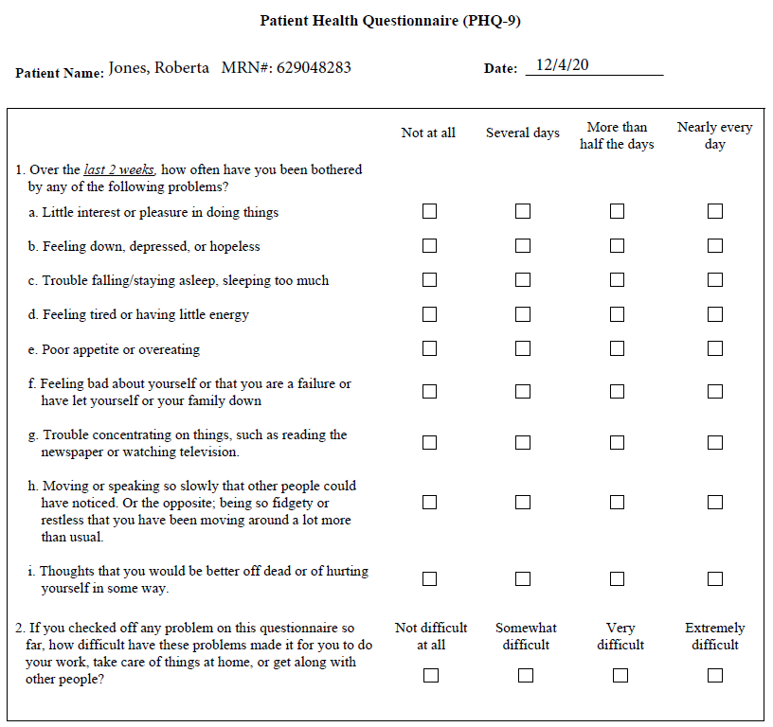
PHQ-9
Notes:
INSTRUCTOR: Show this slide to class, allow student to use this to ask questions. As the patient, your answers will be:
More than half days
More than half days
More than half days
Several days
Not at all
Not at all
More than half days
More than half days
Not at all
2. Somewhat difficult

Slide 10
PHQ-9 Scoring
Not at all = 0
Several days = 1
More than half of the days = 2
Nearly every day = 3
PHQ-9 Score | Depression Severity | Proposed Treatment Actions
0 – 4 | None-minimal | None
5 – 9 | Mild | Watchful waiting; repeat PHQ-9 at follow-up
10 – 14 | Moderate | Treatment plan, considering counseling, follow-up and/or pharmacotherapy
15 – 19 | Moderately Severe | Active treatment with pharmacotherapy and/or psychotherapy
20 – 27 | Severe | Immediate initiation of pharmacotherapy and, if severe impairment or poor response to therapy, expedited referral to a mental health specialist for psychotherapy and/or collaborative management

Slide 11
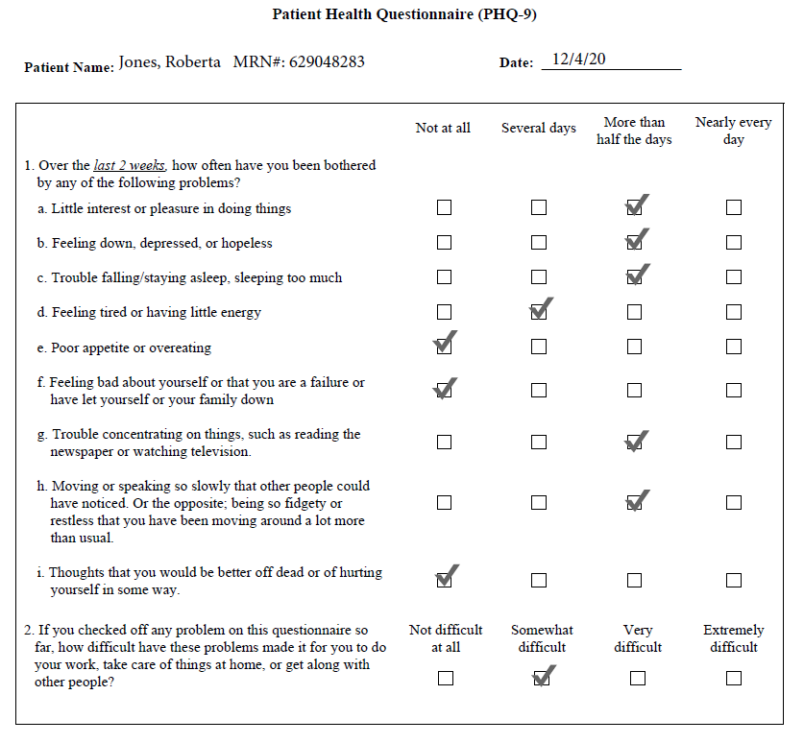
PHQ-9 Results: Score =11
Notes:
Score=11 on PHQ-9

Slide 12
RAPID Approach
ASSESSMENT: Initial Triage & Functional Domains
R | Rapport Building / Reflective Listening
A | Assessment
P | Prioritization
I | Intervention
D | Disposition
1) Initial Triage – Any immediate safety issues?
2) Functioning domains
  Cognitive - E.g. Difficulty making decisions, confusion
  Emotional - E.g. Distress, anxious, sad
  Behavioral - E.g. Avoidance, compulsion, aggression
  Spiritual - E.g. Questioning faith
  Physiologic - E.g. Changes in appetite, body aches
3) Questions can focus on whether patient has noticed any impairment in these 5 domains. Continue open-ended questions.
Notes:
INSTRUCTOR: Provide reminder of need to do initial triage for any immediate/urgent/emergent issues (this patient will not have any apparent emergencies), then ask them to state the functioning domains to assess.
Remind students to ask patient if they have had any difficulty within these domains, by asking open-ended questions. Ask for some examples. Or provide examples, such as, “Have you had any difficulty with thinking things through or making decisions?” If yes, “How so? Tell me more….”

Slide 13


RAPID Approach
ASSESSMENT: DISTRESS VS. DYSFUNCTION
Distress: some impairment or challenges reported, but able to get needs met
Dysfunction: significant impairment or challenges reported, unable to get basic needs met
Sample questions:
  Have these challenges affected your ability to eat, drink fluids, get groceries (or other basic chores done), shower, take medication, sleep, pay bills?
R | Rapport Building / Reflective Listening
A | Assessment
P | Prioritization
I | Intervention
D | Disposition
Notes:
INSTRUCTOR: Ask students to describe differences between distress and dysfunction, then click on mouse button to show them answers.
Also state the sample questions

Slide 14
PAUSE FOR SIMULATION EXERCISE

Slide 15
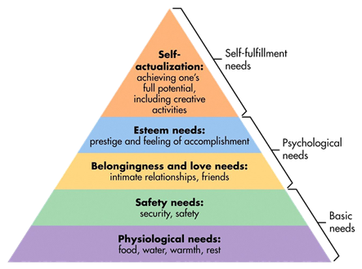
RAPID Approach
PRIORITIZATION & TRIAGE
Basic needs first (as applicable)
Emotional/Psychological needs
  Evidence Based Triage
    Distress or dysfunction based on your observation or patient report
  Risk-Based Triage
    Death
    Dislocation
    Disabling Impact
What additional information is needed to help with prioritization?
  If needed, continue to assess basic needs or areas of dysfunction
  Ask what patient is most concerned about
R | Rapport Building / Reflective Listening
A | Assessment
P | Prioritization
I | Intervention
D | Disposition
Notes:
INSTRUCTOR INFO: For each item to appear, must click on mouse.
Reference Maslow’s Hierarchy and ask students what to prioritize first [CLICK]
Ask students what to prioritize second [CLICK]
Ask them for each type of triage approach and definitions [CLICK]
You can then click through to identify some sample questions or approaches the RN can use for this step.

Slide 16
PAUSE FOR SIMULATION EXERCISE

Slide 17


RAPID Approach
INTERVENTION – STABILIZATION & MITIGATION
Stabilization
  Remove cues
  Allow venting
  Gentle advice
  Provide tasks
Mitigation
  Stress Management
  Explanatory Guidance
  Anticipatory Guidance
  Social Support
R | Rapport Building / Reflective Listening
A | Assessment
P | Prioritization
I | Intervention
D | Disposition
Notes:
INSTRUCTOR INFO: Ask students for examples of stabilization strategies then [CLICK] on mouse for answers
Then, ask students for examples of mitigation strategies, then [CLICK] on mouse for answers

Slide 18
PAUSE FOR SIMULATION EXERCISE

Slide 19

RAPID Approach
DISPOSITION – EVALUATING EFFICACY
Is further care needed?
  Urgent help needed?
  Resources needed?
    Mental health
    Financial
    Spiritual
    Medical
  Other support needed?
Always schedule follow-up
R | Rapport Building / Reflective Listening
A | Assessment
P | Prioritization
I | Intervention
D | Disposition
Notes:
INSTRUCTOR INFO: Ask students for elements of Disposition step, then [CLICK] on mouse for answers
If they do not mention to follow up, then remind them of this element in disposition and [CLICK] on mouse

Slide 20
PAUSE FOR SIMULATION EXERCISE

Slide 21


SBAR – Communication to Providers
What information will you communicate to the doctor?
What information will you communicate to the behavioral health provider?

Slide 22
PAUSE FOR SIMULATION EXERCISE

Slide 23
SBAR – Communication to Providers
What information would you communicate to the doctor?
S: Ms. Roberta Jones, 78-year-old African American female, scored 11 on PHQ-9
B: Patient presented to clinic today for annual physical. She reports increased anxiousness, loneliness, constant worries about COVID-19, feeling stuck at home, unable to do usual social activities or anything productive and disrupted sleep. She does not express suicidal ideation.
A: Patient presenting with significant emotional distress since pandemic and social distancing started and seems anxious and depressed. She is able to get basic needs met, but is tired due to lack of sleep and with potential for further deterioration if she does not receive further support.
R: Educated & recommended counseling to patient through our social work department. With her consent, I will submit a referral and ensure appointment is scheduled. RN to follow up with patient in 1 week.
Notes:
DIANA: I am not familiar with SBARs, so please do correct/edit as appropriate. Thank you!

Slide 24
SBAR – Communication to Providers
What information will you communicate to the behavioral health provider?
S: Ms. Roberta Jones, 78-year-old African American female, scored 11 on PHQ-9
B: Patient presented to clinic today for annual physical. She reports increased anxiousness, loneliness, constant worries about COVID-19, feeling stuck at home, unable to do usual social activities or anything productive and disrupted sleep. Spouse passed away 4 years ago and patient reports thinking of him more, now that she is alone in house, without any other social activities in place. She does not express suicidal ideation.
A: Patient presenting with significant emotional distress since pandemic and social distancing started and seems anxious and depressed. She is able to get basic needs met, but is tired due to lack of sleep and with potential for further deterioration if she does not receive further support. Patient is very overwhelmed with multiple changes and losses due to COVID-19.
R: Provided general counseling and validation of feelings, educated patient on stress management (deep breathing), encouraged to contact friends by phone or email, advised on appropriate precautions for COVID-19 & recommended counseling to patient through social work department. Patient agreeable to social work referral, which has been submitted. Please contact patient to schedule appointment and let me know when this is confirmed. Thank you.

