Slide 1
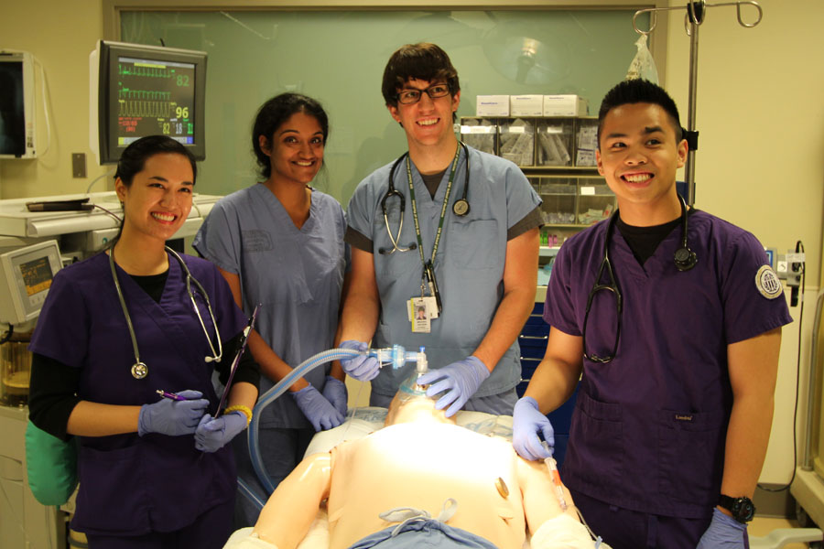
Faculty Development: IPE Facilitation Skills Training for “IPE Facilitation Challenges”
Developed by:
Debra Liner, Program Operations Specialist (UW School of Nursing)
Brenda Zierler, PhD, RN, FAAN (UW School of Nursing)
Erin Blakeney, MA, RN, PhD-C (UW School of Nursing)
Mayumi Willgerodt, PhD, MPH, RN (UW School of Nursing)
Karen McDonough, MD (UW School of Medicine)
Sarah Shannon, PhD, RN (UW School of Nursing)
Support for the development of these materials was provided by: the Division of Nursing (DN), Bureau of Health Professions (BHPr), Health Resources and Services Administration (HRSA), Department of Health and Human Services (DHHS) under grant number D09HP25029, title "Advanced Nursing Education.”
Last Updated: December 6, 2017

Slide 2
Session Objectives
Understand common facilitation challenges in interprofessional learning groups
Identify effective facilitation strategies

Slide 3
Facilitation Workshop Agenda
Overview of facilitation in IPE (theory and common challenges)
Pre-recorded video clips of facilitation challenges
Utilize template to identify IPE challenges, types of interaction between students/faculty, strategies for facilitating
Large group discussion – wrap-up
Evaluation of workshop

Slide 4
CAIPE Competencies for IP Teaching
Commitment to IPE
Understanding of roles & responsibilities in the different professions
Positive role modeling
Understanding group dynamics
Valuing diversity
Ability to use professional differences creatively within groups
Deep understanding of and skill in using active learning methods
*Expert facilitation
[Freeth et al. (2005, p. 106); Reeves et al. (2007)]

Slide 5
Facilitation
  “A technique by which one person makes things easier for others” (Heron, 1989, p.152)
  IPE requires facilitation, enabling students to learn with, from, and abut each other so that students “make their own meaning” (Barr, 2002)
  Facilitation role – maintain group focus and cooperation
  Teaching IP learners requires an understanding of content & an awareness of the importance of process
  Complex and demanding activity

Slide 6
Faculty Development – Why?
Need experienced facilitators to identify difficult situations and opportunities to encourage students to examine and challenge biases, perceptions, and frustrations relating to various health professional groups

Slide 7
Faculty Development — Rationale
Rationale for faculty development (FD)
  Unprepared (don’t know content of IPE program)
  Poor conceptual understanding of core IPE & interprofessional collaboration principles
  Missed teachable moments (Lee et al., 2011)
  JIT training focuses on logistics of activity (FD needs to be a long-term and ongoing process not one-time event) (Ruiz et al., 2013)

Slide 8
Faculty Development — Facilitation Challenges
Cultural presence of uniprofessional education (tradition and group identity)
Lack of understanding around the professional learning requirements (outside own background)
When to intervene with students and lead interprofessional learning in a didactic fashion vs. allowing students to direct their own learning (Lindqvist and Reeves, 2007)

Slide 9
Faculty Development — Facilitation Challenges
Ability to manage tension, conflict and breakdown in communication among group of learners
Managing unengaged and disruptive students
Authenticity of clinical cases (typically based in one profession rather than multiprofessions) (Di Prospero & Bhimji-Hewitt, 2010)

Slide 10
Strategies for IPE Facilitation
Creation of supportive environment
Create supportive environment
Show respect and appreciation for the roles of diverse health professionals
Promote team formation & conflict resolution
Have insight into one’s professional practice
Create team charter or ground rules
(Crow and Smith, 2003; Lindqvist and Reeves, 2007; Reeves and Freeth, 2002; Banfield & Lackie, 2009; Howkins and Bray, 2008)

Slide 11
Types of Interactions between Students & Facilitators
 | Definition | Purpose
Facilitator-controlled interactions | One-way interaction from facilitator to students | To describe the activity & learning objectives; set the ground rules; express beliefs concerning IPP
Facilitator-driven interactions | Interaction between facilitators & students; directed by facilitators | To encourage students’ participation; to focus the discussion; animate the discussions
Student-driven interactions | Interaction between students & facilitators; directed by students | To take ownership of the discussion
(Ruiz et al., 2013)

Slide 12
Faculty Competency in IPE Facilitation: Role & Skills
Role
Promote benefits of IP learning for teamwork
Provide encouragement & support
Encourage interaction and collaboration
Foster knowledge & skills necessary for good teamwork (e.g. mutual respect)
Provide direction and focus toward learning objectives without making decisions
(Freeman et al., 2010)

Slide 13
Faculty Competency in IPE Facilitation: Role & Skills
Skills
Be professionally neutral
Encourage, motivate and support process
Listen actively
Understand and respond to group dynamics
Encourage diplomacy
Encourage diversity
Be flexible
Observe, reflect and summarize
(Freeman et al., 2010)

Slide 14
Small Group (table) Exercise – video clips
Play selected Facilitation Challenges Videos
(see next slide for further instructions)

Slide 15
Small Group (table) Exercise – video clips
After each video clip… Using template (one per table)
Identify IPE challenge(s) demonstrated in the video clips
Identify type of interaction between students and faculty
Identify the underlying IPE competency being addressed
Discuss and reflect on the roles and skills of the facilitators
Identify 1‒2 facilitation strategies that could have been used

Slide 16
Large Group Debrief
What went well?
IPE challenges identified?
What was the type of interaction between students and faculty?
What did the groups think of the roles and skills of the facilitators?
What facilitation strategies could have been used?
Discuss other challenges experienced in IPE facilitation or discuss specific video clips.

Slide 17

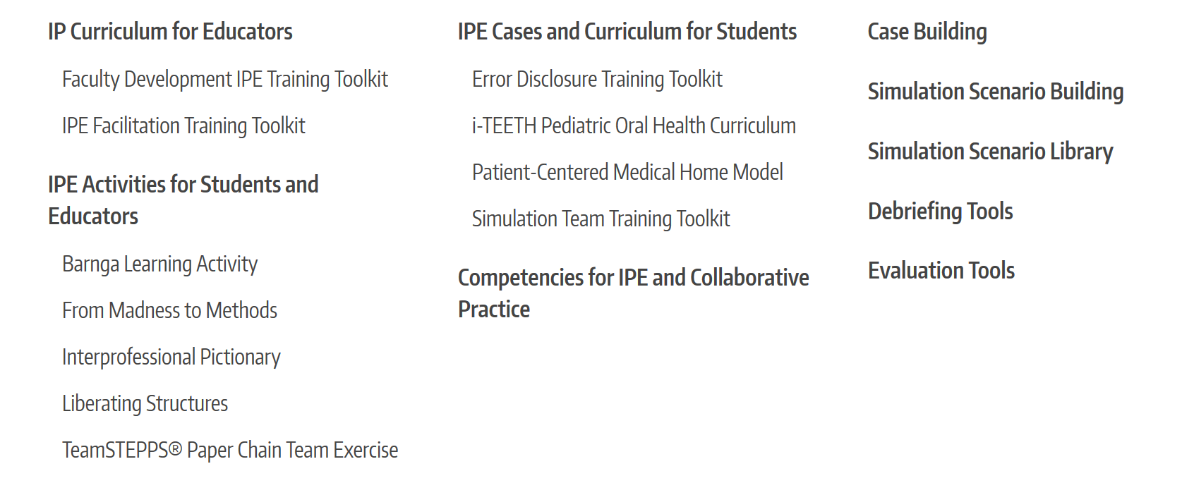
Additional Resources: www.collaborate.uw.edu

Slide 18
Evaluations
Thank you for participating in this
IPE Facilitation Training Workshop!
Please take a moment to
complete the workshop evaluation.

Slide 19
UW TEAM ‒ Acknowledgements
Debra Liner, BA
Karen McDonough, MD
Erin Abu-Rish Blakeney, BSN, MA, PhD candidate
Lynne Robins, PhD
Jennifer Danielson, PharmD, MBA
Linda Vorvick, MD (PA program)
Sarah Shannon, PhD, RN
Mayumi Willgerodt, PhD, MPH, RN
Jennifer Sonney, MN, ARNP
Emily Malik, BS (grad student in SLP)
Laurel Barchet, BS, RN
Peggy Schlesinger, MD
Julie Calcavecchia
John Balzarini
Chris Gambol

Slide 20
Acknowledgements
Josiah Macy, Jr. Foundation & HRSA
UW Center for Health Sciences Interprofessional Education, Research & Practice (CHSIE)
UW Health Sciences Dean’s Initiative in IPE
UW School of Medicine, Center for Leadership & Innovation in Medical Education
UW School of Nursing - Technology Innovation in Education & Research (TIER)
Lynne Robins, PhD, UW School of Medicine Teaching Scholar’s Program
UW IHI Open School Chapter and Student Actors

Slide 21
References (1 of 3)
Freeth, D., Hammick, M., Reeves, S., Koppel, I., Barr, H. (Ed) (2005) Effective Interprofessional Education: Development, Delivery & Evaluation. Oxford: Blackwell Publishing Ltd.
Reeves, S., Goldman, J., Olandasan, I. (2007). Key Factors in Planning and Implementing Interprofessional Education in Health Care Settings. Journal of Allied Health; 36 (2), 231-235. PMID: 18293805
Heron, J. (1989). The Facilitator’s Handbook. Kogan Page, London.
Barr, H. (2002). Interprofessional education: Today, yesterday, and tomorrow. The Learning and Teaching Support Network for Health Sciences & Practice from the UK Centre for the Advancement of Interprofessional Education. Retrieved from http://www.hsaparchive.org.uk/doc/mp/01-03_hughbarr.pdf/view.
Egan-Lee, E. et al. (2011).Neophyte facilitator experiences of interprofessional education: implications for faculty development. Journal of Interprofessional Care, 25(5): 333–338. DOI: 10.3109/13561820.2011.562331.

Slide 22
References (2 of 3)
Ruiz, M. G., Ezer, H., & Purden, M. (2013). Exploring the nature of facilitating interprofessional learning: findings from an exploratory study.Journal of interprofessional care, 27(6), 489–495. doi:10.3109/13561820.2013.811640
Di Prospero, L., & Bhimji-Hewitt, S. (2011). Learning is in the facilitation: faculty perspectives with facilitated teaching and learning-recommendations from informal discussions. Journal of allied health, 40(4), e61–65.
Crow, J. & Smith, L. (2003). Using co-teaching as a means of facilitating interprofessional collaboration in health and social care. Journal of Interprofessional Care, 17(1), 45-55. PMID:12772469.
Lindqvist, S. M., & Reeves, S. (2007). Facilitators’ perceptions of delivering interprofessional education: a qualitative study. Medical teacher, 29(4), 403–405. doi:10.1080/01421590701509662
Reeves, S., Freeth, D. (2002). The London training ward: An innovative interprofessional learning initiative. Journal of Interprofessional Care, 16(1), 41-52. PMID:11915715

Slide 23
References (3 of 3)
Banfield, V. & Lackie, K. (2009). Performance-based competencies for culturally responsive interprofessional collaborative practice. Journal of Interprofessional Care, 23(6):611-20. DOI:10.3109/13561820902921654
Howkins, E. & Bray, J. (2008). Preparing for interprofessional teaching: Theory and practice. New York, New York: Radcliffe Publishing.
Freeman, S., Wright, A., & Lindqvist, S. (2010). Facilitator training for educators involved in interprofessional learning. Journal of interprofessional care, 24(4), 375–385. doi:10.3109/13561820903373202

